Slide 1

Agile Test Development
T
STP Conference 2006
Hans Buwalda
LogiGear Corporation

Slide 2
Scope of This Workshop
Test development,
  not agile system development or Extreme Programming (XP)
Goal is practical concepts and experiences
  not necessarily intended to add to the discussions about agile methods
Topical approach
  offering ideas, concepts, experiences, not the ultimate life cycle
  input welcome

Slide 3
Topics for this Workshop
Agile test development
  focus on “test development”, as opposed to “testing”
Efficient Test Automation
  allowing for short test life cycles
  introducing Action Based Testing as an example
Agile test development techniques
  in particular Soap Opera Testing
Case studies

Slide 4
“Waterfall” Life Cycle
Establish requirements
Design and develop system
Test the system
Production and maintenance

Slide 5
Agile System Development
Establish requirements (global)
Develop tests
Develop the system, test driven
Production and maintenance

Slide 6
The “Values” concept in
Extreme Programming
Communication
Simplicity
Feedback
  key contribution from tests (unit tests and functional tests)
Courage
Respect

Slide 7
Additional option?
“Chief Programmer Teams”
From the classic “Mythical Man Month” by Fred Brooks
  Brooks law: “Adding manpower to a late software project makes it later”
One chief, one assistant, plus supporting disciplines
  compared to surgical teams
  based on the assumption that one good programmer is 5-10 times more effective than a mediocre one

Slide 8
The “Surgical Team”
Surgeon/Chief Programmer, who does actual development, design, testing, and documenting.
Copilot, the Surgeon's right hand man.
Administrator, who handles money, space, equipment, etc.
Editor, a technical writer who finishes the Surgeon's documentation.
Secretaries, one each for the Administrator and Editor.
Program Clerk, who manages technical records for the team
Tool-smith, who manages custom tools for the team and the development environment.
Tester, who defines and executes test cases.
Language Lawyer, a programming language expert for some programming language of interest.

Slide 9
Agile “Home Ground”
*
Low criticality
Senior developers
Requirements change very often
Small number of developers
Culture that thrives on chaos
*
Barry Boehm and Richard Turner
Balancing Agility and Discipline: A Guide for the Perplexed
Addison-Wesley, 2004

Slide 10
Plan-driven “Home Ground”
High criticality
Junior developers
Low requirements change
Large number of developers
Culture that demands order

Slide 11
Why Better Test Development?
Are your suffering from lame tests too?
Many tests are “mechanical” now
  blindly follows specs or reqs
  which is good, but lacks aggression
  I call these “medium ambition level”
To make tests with a higher “ambition level” you need
  understanding of the system under test, and the “business under test”
  analytical understanding of “what could go wrong”
  creativity, and the commitment to use it
Poor test development results in
  cumbersome automation
  tedious retest cycles, loosing the agile advantage
T

Slide 12
Why Agile Test Development
Informational reasons
  tests are a natural means of communication with users, capturing “agreement” on specs and their meaning
  tests capture business, functional and technical information, favoring frequent interaction
Planning reasons
  tests are individual, they can be developed as small units, independently from
    system under test
    each other
  test development is sensitive to overall planning, needs to be flexible
  in methods like XP functional tests are input for system development
In fact “agile” is a natural way to develop good tests
  test development is often agile even in waterfall projects

Slide 13
Agile Test Development
TEST DEVELOPMENT
Testers
Stakeholders
AUTOMATION
Tests can drive the development
SYSTEM DEVELOPMENT
Developers
Stakeholders

Slide 14
Recommendations
Have a global test design (this may differ from XP)
  keep it short and simple: focused on breakdown of the tests
  this global test design can (and usually should) be revisited during the project
Split between (1) test requirements and (2) test cases
  I have experienced test requirements are easier to create and communicate about
Make the automation a separate activity
  test developers are not bogged down by it
Use stake holders wisely
  focus the efforts on the relevant tests
  don’t bother them more than need (with low and medium ambition level tests)
  various kinds of input:
    how does this work
    what do we need to test
    what is interesting to test / how can we break the system

Slide 15
Role of Automation
Automation can allow tests to support agile system development
  for unit tests, but also for functional tests
Automation is separate from test development
  usually doesn’t need user interaction (only some with testers)
  in keyword methods like Action Based Testing the automation focuses on actions, not on tests

Slide 16
Success Factors for Automation
Accessible and maintainable test structure
High degree of automation
High re-use
At least as maintainable as the system under test
Test specification separate from automation
  At the same time avoiding double work between tester and engineer

Slide 17
Action Based Testing
Provides a framework for effective automation
Based on a notion that a test can be broken down in a number of consecutive actions
Both actions and their data are in products, called "Test Modules"
  Excel spreadsheets for easy development and communication
  test data is explicit or with a place holder
  explicit checks with specified expected result values
  most actions are "high level", omitting as many unneeded details as possible
Instead of implementing test cases, the automation concentrates on the programming individual actions

Slide 18
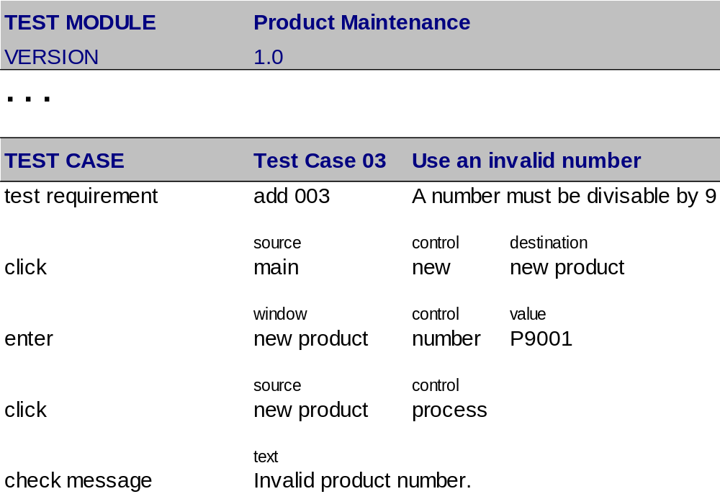
Example of a Test Module

Slide 19
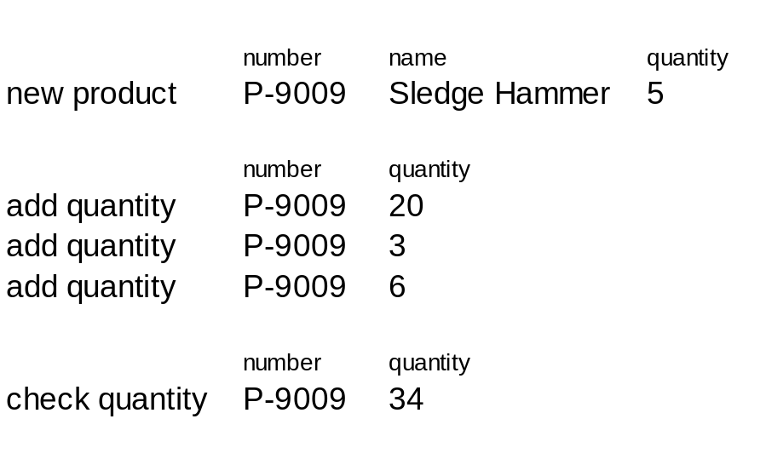
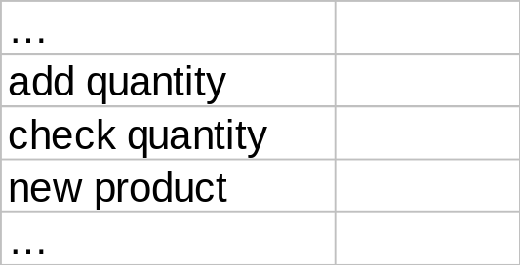
Separation of Tests and Automation
Test Module
(Excel Spreadsheet)
Automation

Slide 20
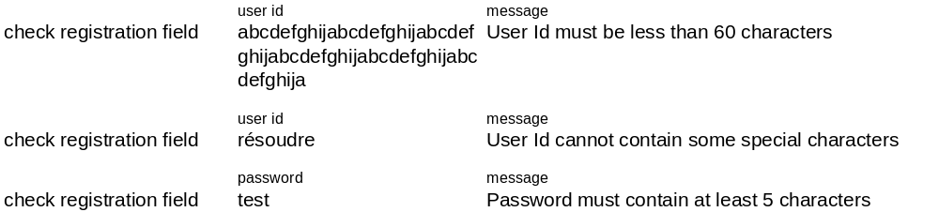
Example of "Old and New" Formats
Most values are implicit. The tester has to figure out during execution….
Same instruction repeated over and over again…
Current format
Enter a User Id, which is greater than 60 characters and enter proper information for all other fields and click on the "Continue" button | Error message should be displayed with "User Id must be less than 60 characters".
Enter a User Id with special character's) and enter proper information for all other fields and click on the "Continue" button | Error message should be displayed indicating the "User Id cannot contain some special characters".
Enter the information, with a password of 4 characters and click on the "Continue" button | Error message should be displayed with "Password must contain at least 5 characters".
ABT format
Action "check registration field", defined to (1) enter all fields with standard values, except the one specified, and (2) to check if the specified message comes up.

Slide 21
Use of Test Requirements
...
TR-3.51 The exit date must be after the entry date
...
test requirement TR-3.51
name entry date exit date
enter employment Bill Goodfellow 2002-10-02 2002-10-01
check error message The exit date must be after the entry date.

Slide 22
Breakdown: Divide and Conquer
Mission, Priorities, Information, Planning, Budget, Stakeholders, ...
Breakdown
Priority and planning
what
when
who
how
development
development
development
development
execution and follow up
execution and follow up
execution and follow up
execution and follow up
maintenance
maintenance
maintenance
maintenance

Slide 23
Action Based Testing
Test Development Plan
Test Module
Test Module
Test Module
Test
Requirements
Test
Requirements
Test
Requirements
. . .
Test Cases
Test Cases
Test Cases
Actions
ACTION AUTOMATION

Slide 24
Not Likely to be Good Breakdown
Combinations of low and high level tests in one module
When you have to change all modules for a new system release
If all modules look alike
Modules are dependent on each other
You can’t start developing them now

Slide 25
Breakdown "Cheat Sheet"
Straightforward Criteria
  Architecture of the system under test (which part are we testing)
  Functionality and other requirements
  Kind of test (navigation flow, quality attributes, ...)
  Ambition level (smoke test, regression, requirement based, aggressive, …)
Additional Criteria
  Stakeholders
  Complexity of the test
  Technical aspects of execution
  Planning and control
  Risks involved
  Code hand-offs

Slide 26


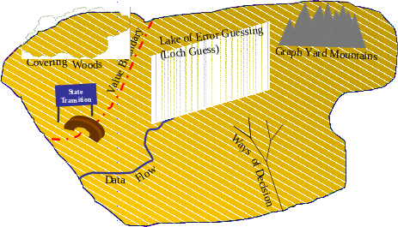
The Realm Of Techniques
Lake of Error Guessing
("Loch Guess")
Covering
Value Boundary
Graph Yard
Mountains
Woods
State
Transition
Ways
Flow
of
Data
Decision
Soap Opera
Testing
Equivalence Island

Slide 27
The “Mechanical Approach” for Test Development
Start with a (preferably long) list of requirements
Make a test case for every requirement
Use a standardized test technique to translate the requirements into test cases
Hire (many) people to perform the tests manually
….

Slide 28
Pitfalls With a Too Mechanical Approach
No fun at all
Inhibiting creativity
Coverage is focused at single requirement level
Any defects should probably have been found in an earlier test
Suggests false sense of control
Test set hard to maintain
Doesn’t catch mistakes in the requirements

Slide 29
Soap Operas
Ashley hears about Jack's deposit when he thought he had
to go. Victoria lectures her father about what's wrong with him
and Nikki but Victor advises her that it's none of her business
Olivia learns Dru has no regrets about leaving and takes great
satisfaction in having Lily as her companion. Dru then asks Olivia
why she is raking Malcolm over the coals. Stopping by Gina's,
Nikki spots Brad and sits with him, admitting she doesn't want to
be alone tonight. Victor stops by Mack's party at the Crimson
Lights. Ashley takes a home pregnancy test. Worried about Billy,
Raul makes call and J.T. claims he doesn't know where Billy is.
Raul rushes over and finds Billy out cold in the snow. Raul worries
when he can't find a pulse. . . .
Reference: “Soap Opera Testing”, Hans Buwalda, Better Software Magazine, February 2004

Slide 30
Some Other Examples
Pension Fund
William starts as a metal worker for Industrial Enthropy Incorporated in 1955. During his career he becomes ill, works part time, marries, divorces, marries again, gets 3 children, one of which dies, then his wife dies and he marries again and gets 2 more children….
World Wide Transaction System for an International Bank
A fish trade company in Japan makes a payment to a vendor on Iceland. It should have been a payment in Icelandic Kronur, but it was done in Yen instead. The error is discovered after 9 days and the payment is revised and corrected, however, the interest calculation (value dating)…

Slide 31
Properties of Soap Operas
About “real life”
But condensed
And more extreme

Slide 32
Soap Operas for Testing
Define a scope of the test to develop
Identify with the business environment
Identify which elements would make things difficult
Draft test cases (typical some dozen lines)
Write them down in modules

Slide 33
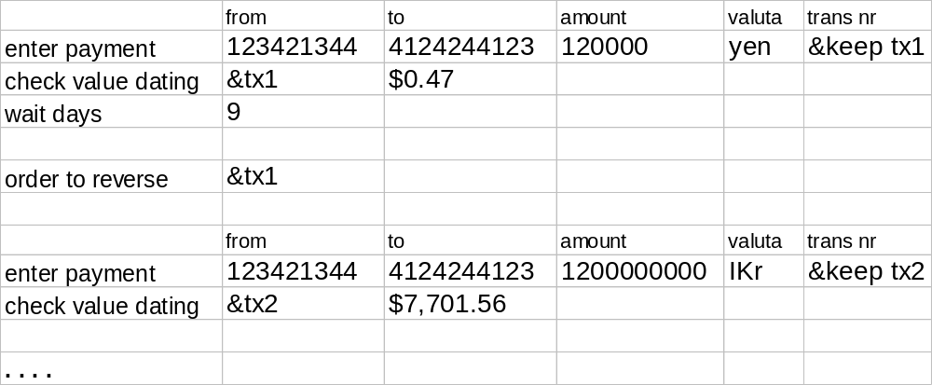
Example of test lines

Slide 34
Soap Operas (in Testing) are not Necessarily
“Extreme”
Far fetched
Long and elaborate
Pieces of art and creativity

Slide 35
“Killer Soaps”
let me wash
this thing...
More specifically aimed at finding hidden problems
Run when everything else has passed
One option: put a killer soap at the end of a normal module
Ask the users and specialists for input

Slide 36
Case 1
Major IT company
Large scale web development project
  complete redesign of key site
Business owners are the main stake holders
  help define the system
  are responsible for “User Acceptance Test”

Slide 37
Parameters for the Testing
Company wants to obtain automated re-usable tests
  the site will undergo frequent changes
  failures are not an option, so integral retest is needed after each change
All tests to be approved by the stake holders
  different stake holders for different areas
Functional specs available, but much additional input from stake holders needed
Because of the volume and available timelines use of off-shore resources

Slide 38
Chosen Approach
After an overall plan of approach a specific Test Development Plan was written
  establishing the test modules
  assigning stake holders
  defining time lines
Two coordinators formed the core of the project
  coordinating stake holder
  coordinating lead test developer, US based
Tests were developed and automated using Action Based Testing

Slide 39
Review Stake Holders
START
Test Team sends draft Module to Stake Holder
Stake Holder reviews:
- coverage
correctness
changes needed?
no
Stake Holder returns notice of approval
yes
Test Team receives and processes notes
Stake Holder returns notes:
additions
corrections
Test Team marks the Module as "Final"
END

Slide 40
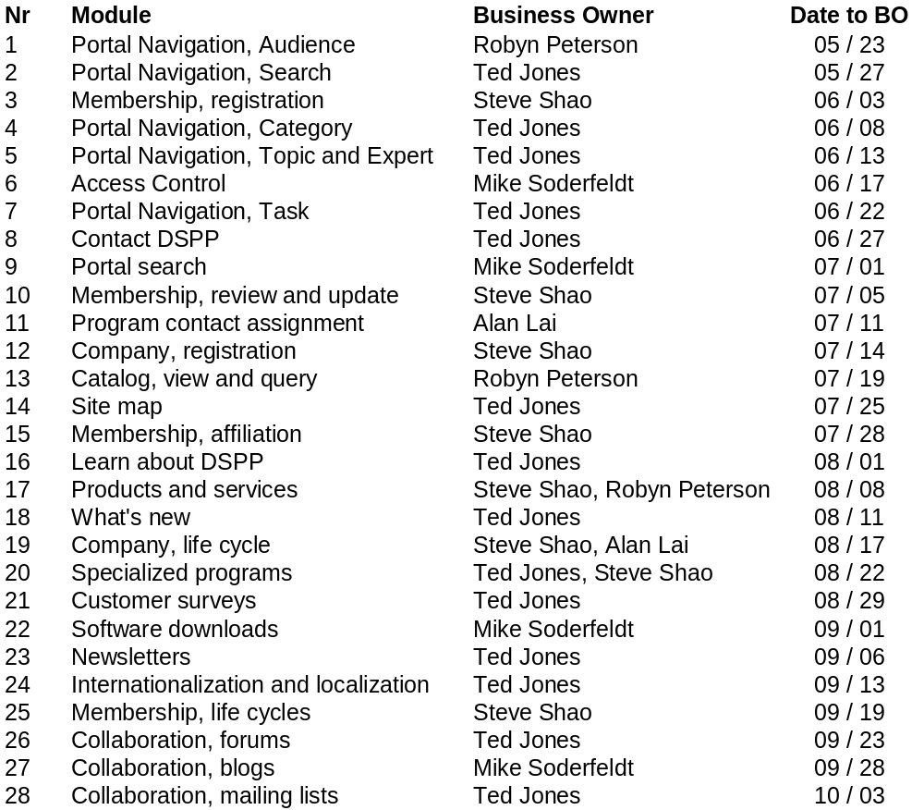
Module Development Planning

Slide 41
Status of the Project
Main project delayed for technical reasons
UAT tests have been run, but will be run again when the system becomes available in a final state
Methodology now also in use for program and system testing

Slide 42
Case 2
Large Dutch retirement fund for metal industry
Needed a renewal of the key systems, including Y2k
Very high pressed time schedule

Slide 43
Parameters for the Testing
Essential, both functional and legal
Get it done, no matter what
Automation regarded as only way out

Slide 44
Highlights of the Approach
Full automation using Action Words
Use of Soap Opera Testing
  establish test requirements
    often literally following the law
  create story lines to create the test cases
Involve the end users to create the tests
  organized in groups
  eventually one third of the whole company was developing tests

Slide 45
Results for the Project
Project was able to finish in time
Tests were re-run very often, fully automated
Users were well informed on the new system

